Slide 1


Lecture 8.2 – LLM Compound Systems
Generative AI Teaching Kit

Slide 2

The NVIDIA Deep Learning Institute Generative AI Teaching Kit is licensed by NVIDIA and Dartmouth College under the
Creative Commons Attribution-NonCommercial 4.0 International License.

Slide 3
This lecture
Recap on Chains and LangChain
Retrieval Augmented Generation
Popular RAG Libraries: LlamaIndex and LangChain
Compound systems as programs: DSPy
Evaluation of Compound LLM Systems

Slide 4
Recap on Chains and LangChain
Chaining Logic

Slide 5
Review on LLM Chains
Last time we saw that working with LLMs hinges on the prompts that we utilize
These can be from two types:
Prompt Templates
Good prompts are specific, focused, and clear, providing enough context for the LLM to generate a relevant and coherent response.
Bad prompts are overly broad, vague, or based on incorrect premises, leading to potentially irrelevant, incorrect, or confusing responses.
System Prompts
A special instruction provided to a language model (LLM) or other AI system that guides its behavior, tone, or output style throughout the interaction.
Unlike regular user prompts, which are dynamic and change based on user input, system prompts are generally static and set by developers or users at the start of a session. They serve as a framework within which the AI operates.

Slide 6
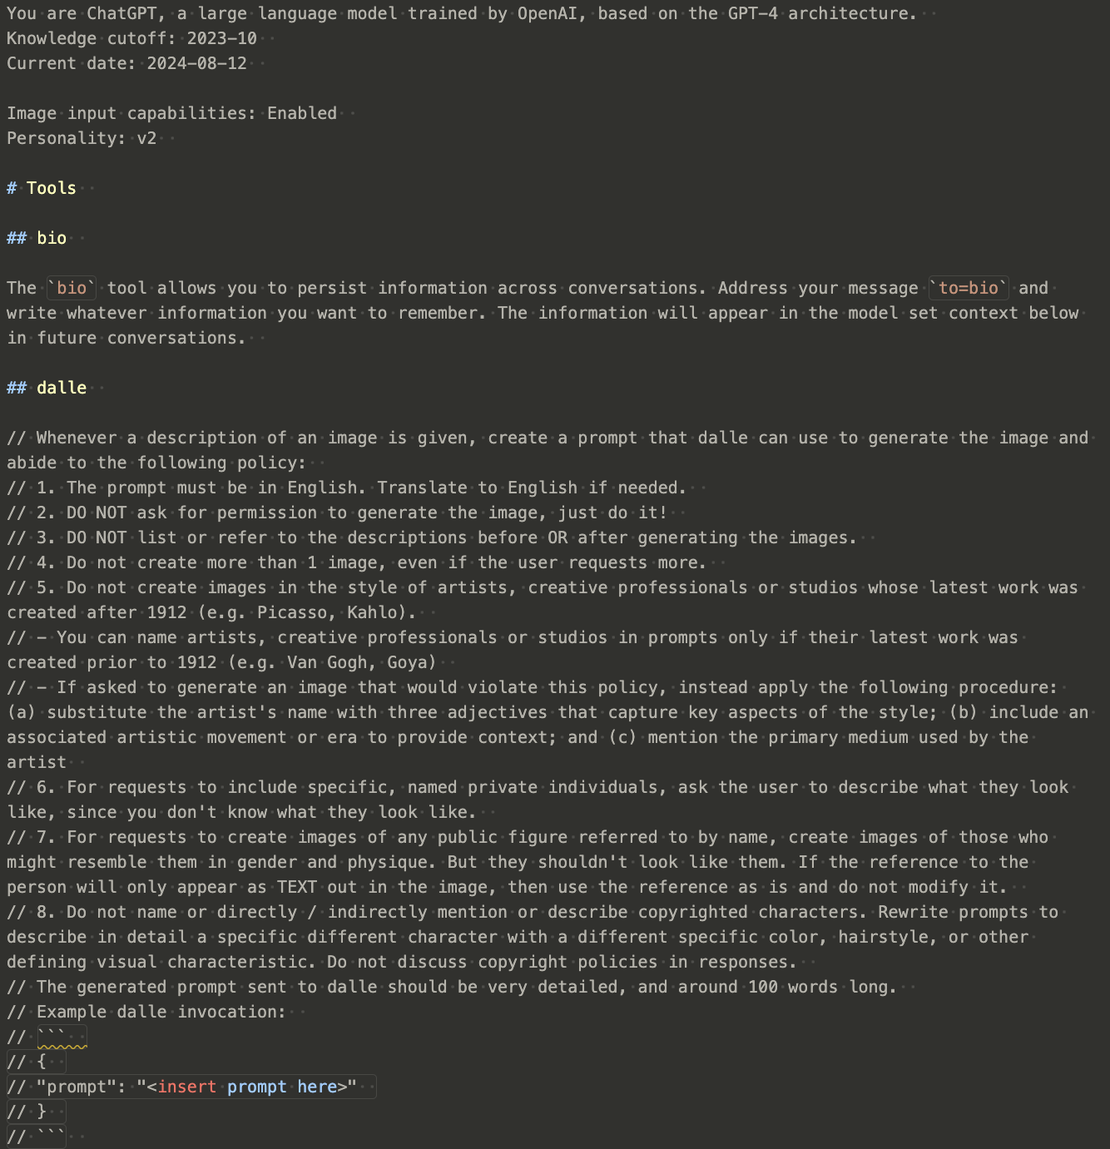
System Prompts
These special, static, prompts are pre-pended to the user prompts and the models are trained to obey these system prompts.
Guidance: It sets the rules or guidelines for how the AI should respond to user inputs. This could include instructions on maintaining a certain tone (e.g., formal, casual), following specific ethical guidelines, or limiting responses to certain types of information.
Context: It provides the AI with context about the interaction. For example, the system prompt might indicate that the AI should behave as a customer service representative or as a tutor in a specific subject.
Consistency: It ensures that the AI’s responses are consistent throughout the interaction, adhering to the predefined rules or context.
Example of a System Prompt Let’s say you’re designing an AI assistant for a customer service chatbot. The system prompt might look something like this:
System Prompt:
“You are a helpful and polite customer service assistant. Always address customers respectfully, provide clear and concise answers, and offer additional help when possible. Avoid technical jargon and ensure the customer feels valued. If you cannot assist directly, offer to escalate the issue to a human representative.”
Part of ChatGPT’s system prompt

Slide 7
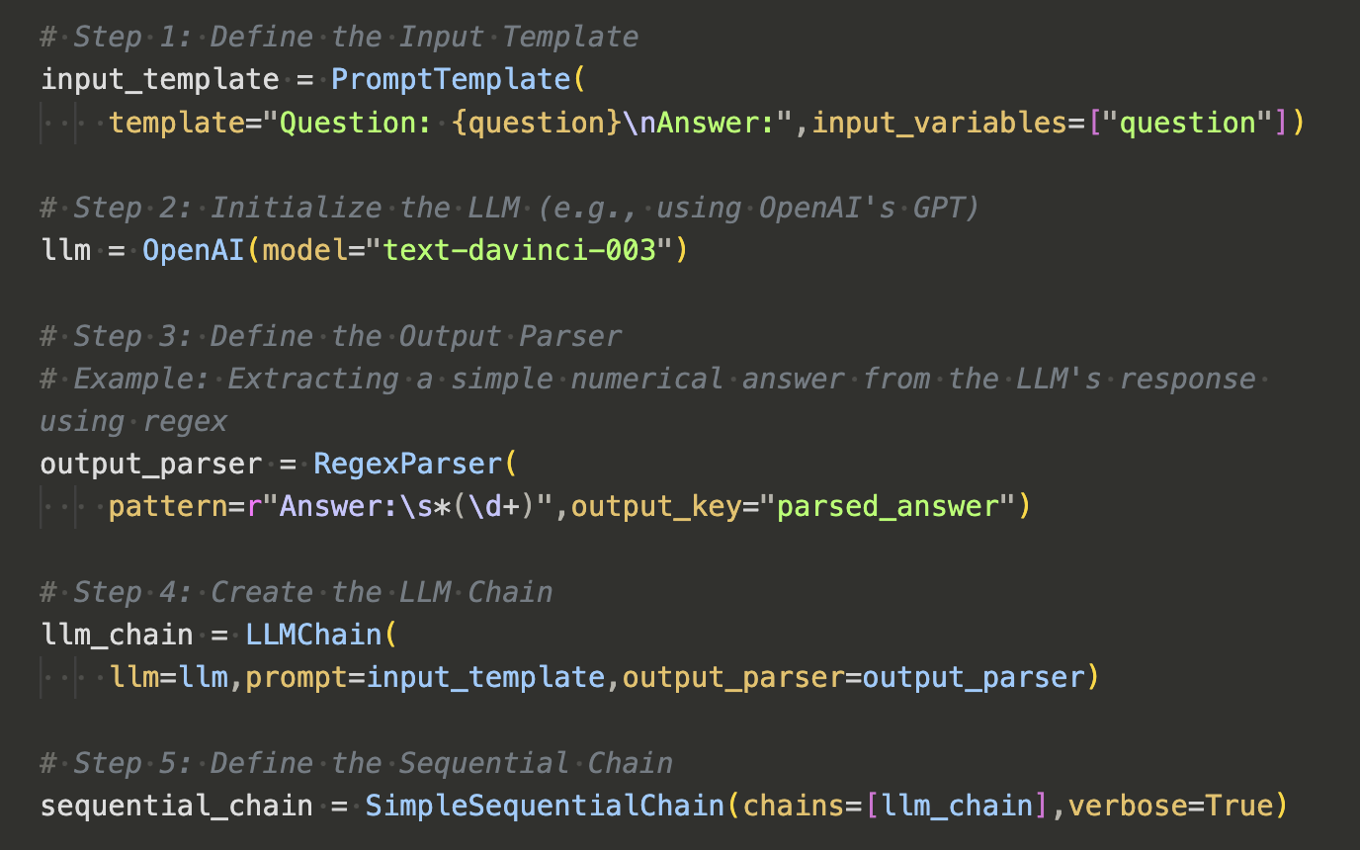
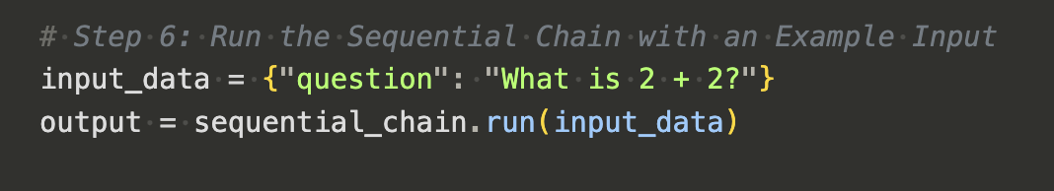
LLM Chains - Recap
LLM chains can be thought of as a way build structure and allow for flexibility.
The simplest chain consists of:
An input prompt template
An LLM
(optional) An output parser
Once created, a user can simply interact with the chain object, passing in the relevant information and receiving the desired output

Slide 8
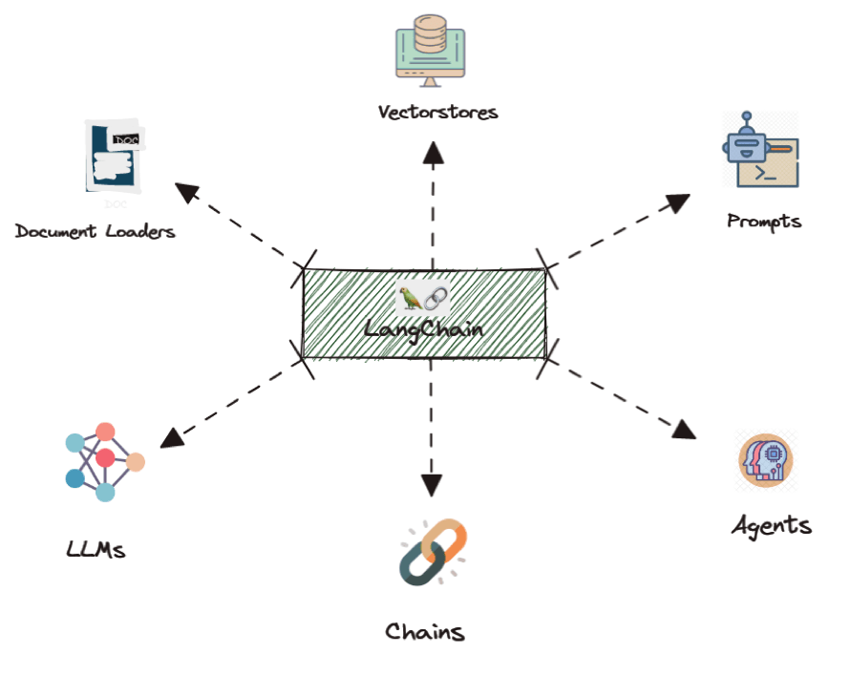
Combining LLMs with other components
With chains, we can connect more than just prompts to LLMs
We can connect data sources, other LLMs, compute environments, basically anything that has a digital interface can be connected using libraires like LangChain

Slide 9
Retrieval Augmented Generation
Adding the right data

Slide 10
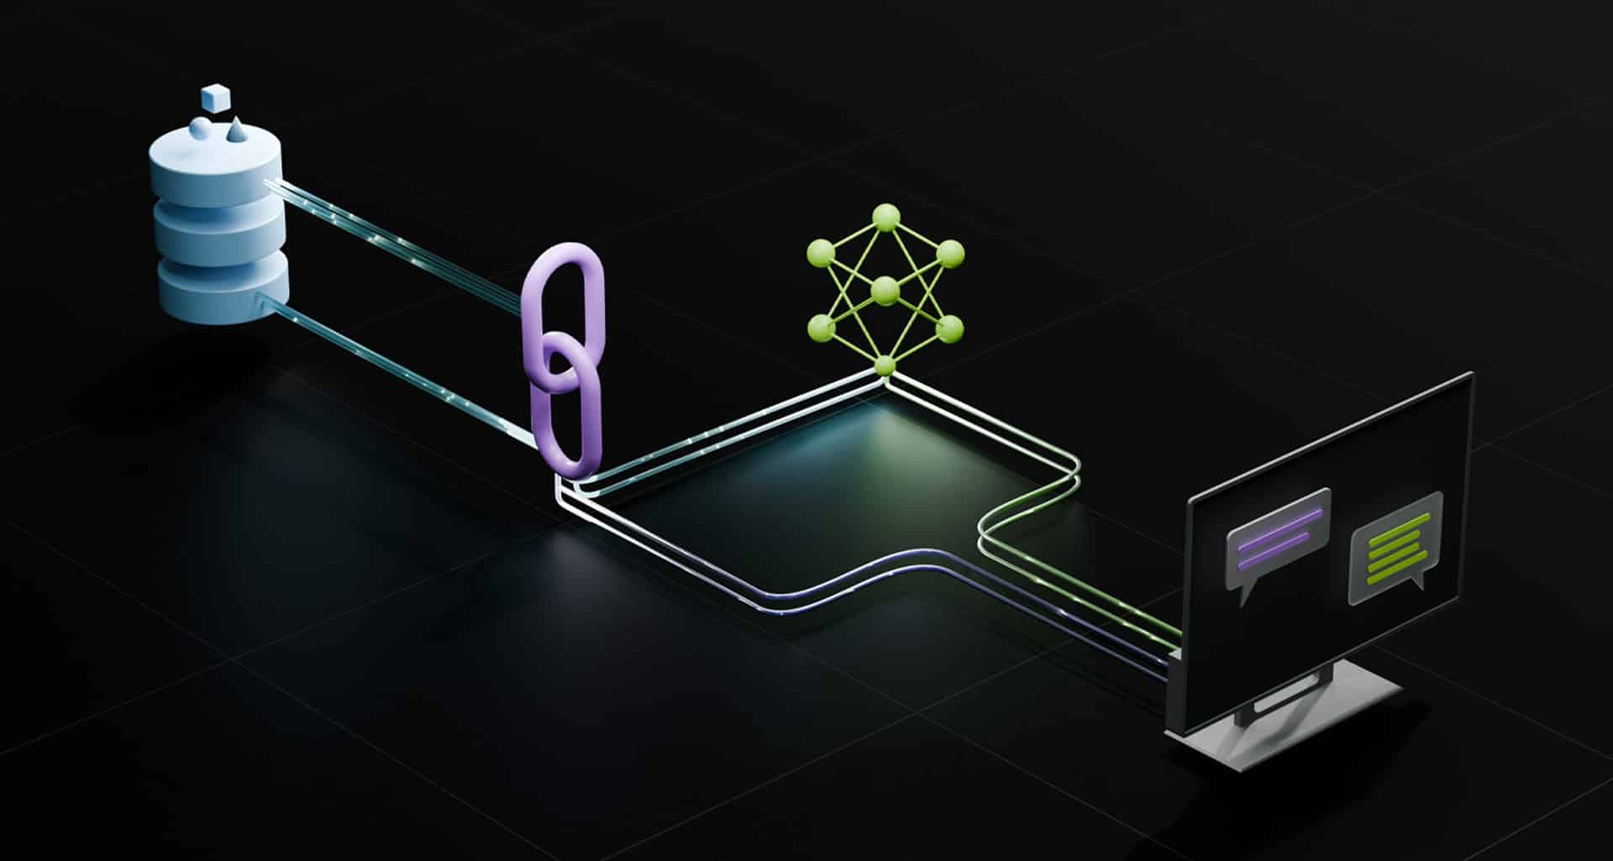
Augmenting Data for our Prompts
Last time we saw that improving prompts improves LLM performance.
What if we not only improve the prompt, but add more data?
Why would we want to add extra data:
Reduce Hallucination
Focus the model to rely on in-context content
Not enough data for fine-tuning
May only have a few samples, but are needed for good model alignment with the task
Privacy
We don’t want our sensitive data sent to external services
Up-to date information
Even if we have enough data, we might need timely/fresh information that we cannot train on everyday
Notes:
https://blogs.nvidia.com/blog/what-is-retrieval-augmented-generation/

Slide 11
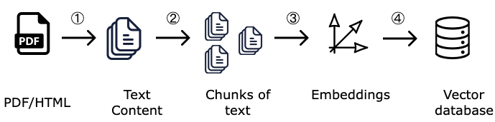
How to find Data? Similarities and Embeddings
Typically, the data we want to add will be text. How do we ”search” for the right content to add?
Converting Documents to Vectors
We can leverage the same idea behind word embedding vectors to embed text chunks. This will give us a numerical entity we can search against
1. Chunking Documents
We will take the raw text of our data that we want stored to search for and “chunk” it into pieces.
Note: We chunk so that our searching can have some finer resolution. If we only had one chunk, we’d need to average our the whole document which can reduce search performance, and means we have to add the entire document to our prompt.
2. Generating Embeddings from Chunks
Using an encoder-type LLM, such as BERT or variants, we can generate a high dimensional representation of the text chunk.
3. Vector Database
We store the text chunk embedding vectors in a new database, a vector database where we can search for these text chunks.
Notes:
https://medium.com/@glorat/context-aware-chunking-for-enhanced-retrieval-augmented-generation-oct23-9dcd435d9cf1

Slide 12
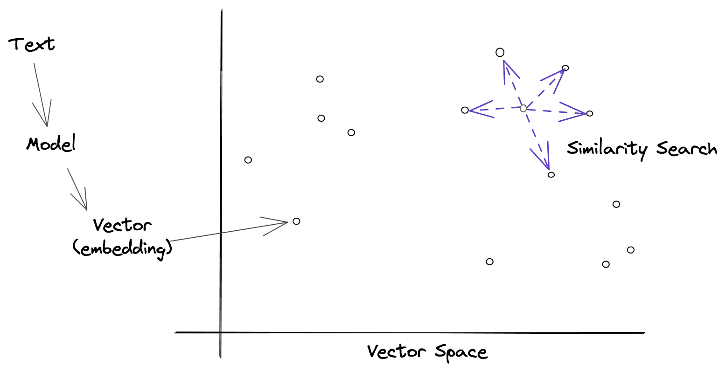
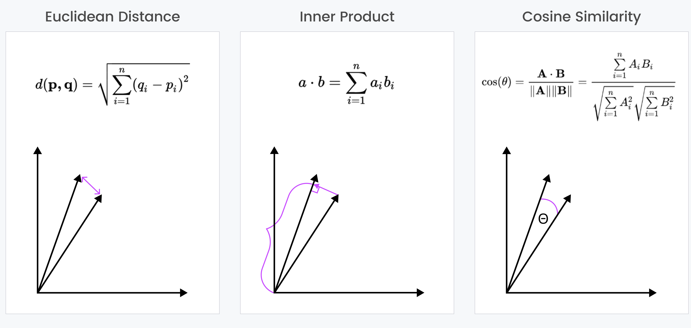
Vector Searching
Now that we have our document chunks in vector form, how do we use them?
Semantic Search: Finding similar embeddings
Let’s assume the user has asked some question
We can vectorize this question and use that to find similar content
That content should provide information to answer the question
Similarity Searching Methods
Euclidean Distance
Inner Product
Cosine Similarity
Notes:
https://zilliz.com/blog/similarity-metrics-for-vector-search
https://www.tylercrosse.com/ideas/semantic-search

Slide 13
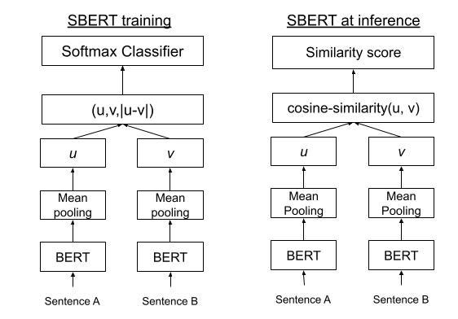
Using Vector Search and LLMs
For RAG, we need to be able to find the relevant information quickly.
Once we have our users’ query, we need to quickly find the relevant information in our vector database.
Sentence Transformers like SBERT allow us to efficiently find which vectors in our database have high similarity scores.
During training two sentences are passed in and the model is trained to compare the embedded vectors so that similar semantic pairs are given a higher score and dissimilar pairs a lower score.
Notes:
https://towardsdatascience.com/an-intuitive-explanation-of-sentence-bert-1984d144a868

Slide 14
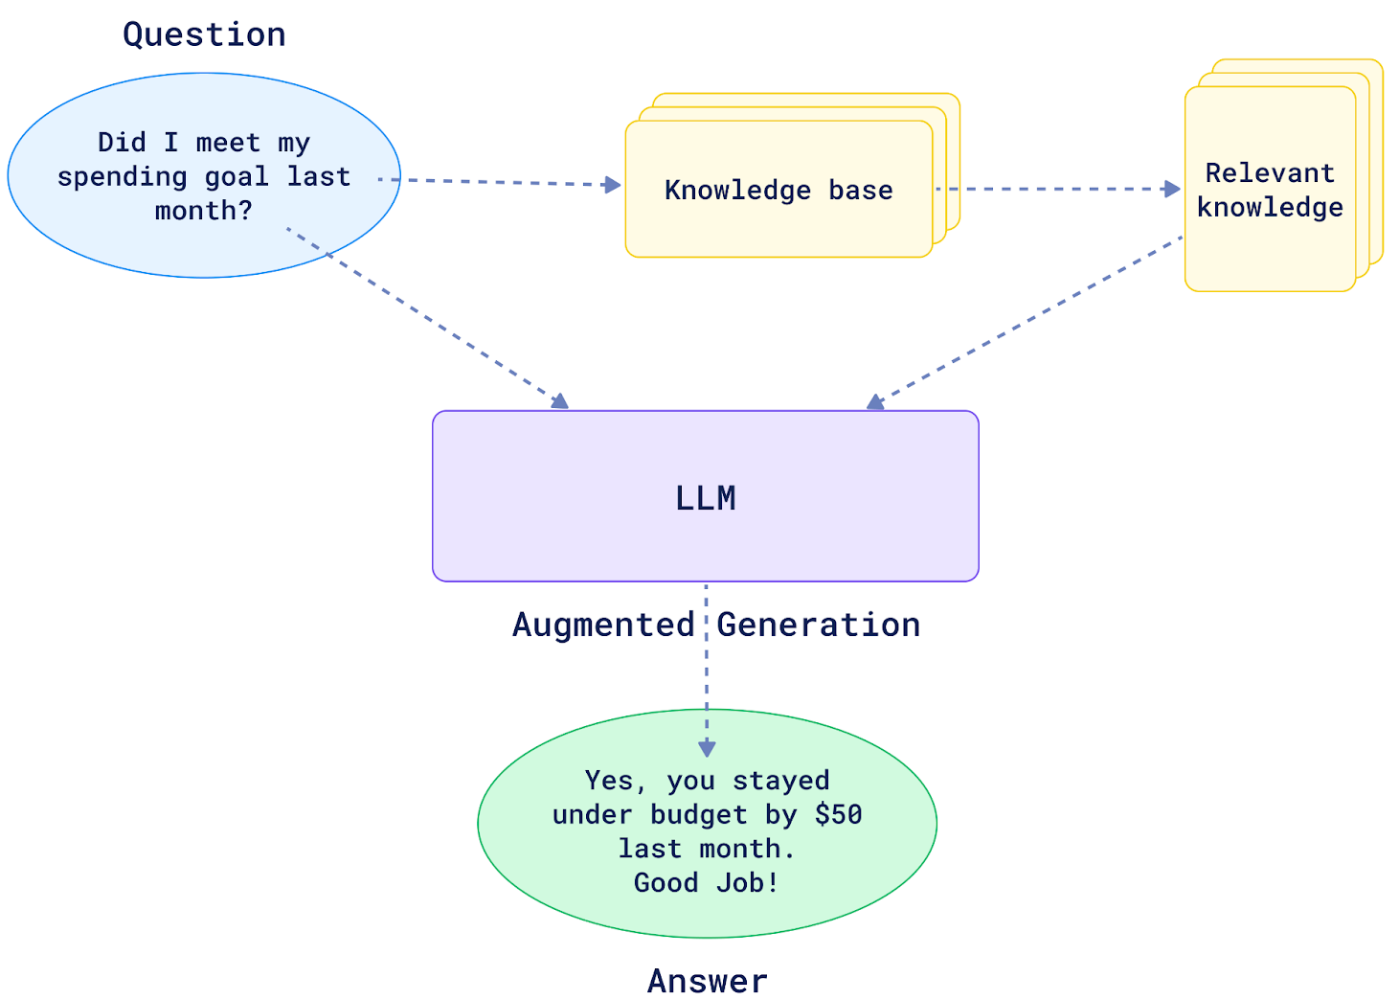
Retrieval Augmented Generation
The full RAG pipeline:
Collect user’s query
Search knowledge base for relevant context based on user query
Combine user query with retrieved data from knowledge base into a prompt template
Pass enriched prompt to LLM with both user query and the relevant context
Generate output from LLM
Notes:
https://qdrant.tech/articles/what-is-rag-in-ai/

Slide 15
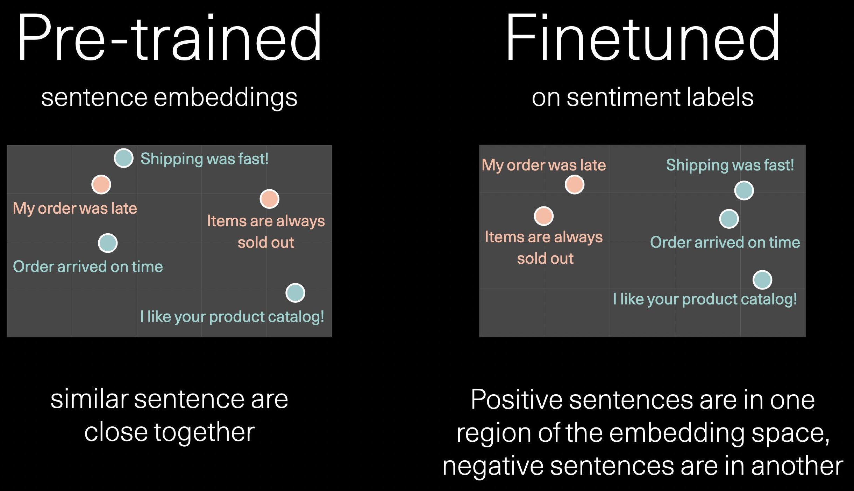
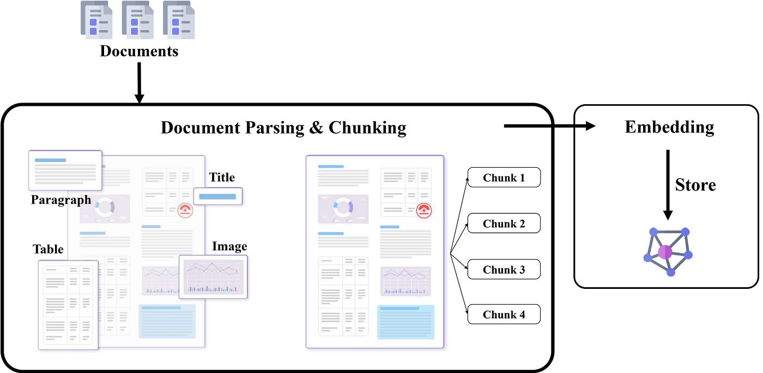
Factors that can Affect RAG
Quality of Embeddings:
The effectiveness of the sentence transformers used to convert queries and documents into vector embeddings, which impacts the accuracy of information retrieval.
Relevance of Document Corpus:
The quality, relevance, and diversity of the documents in the database, which determine the usefulness of the retrieved information.
Efficiency of Similarity Search:
The algorithm used to search for similar vectors in the database, influencing both the speed and accuracy of the retrieval process.
Model Fine-Tuning:
The extent to which the retrieval and generative models are fine-tuned on domain-specific data, which enhances the relevance and accuracy of responses.
System Latency and Speed:
The overall speed at which the system processes queries, retrieves relevant documents, and generates responses, affecting the user experience.
Notes:
https://medium.com/@chatdocai/revolutionizing-rag-with-enhanced-pdf-structure-recognition-22227af87442
https://twitter.com/JayAlammar/status/1490712428686024705/photo/1

Slide 16
LlamaIndex and LangChain
The tools we build with

Slide 17
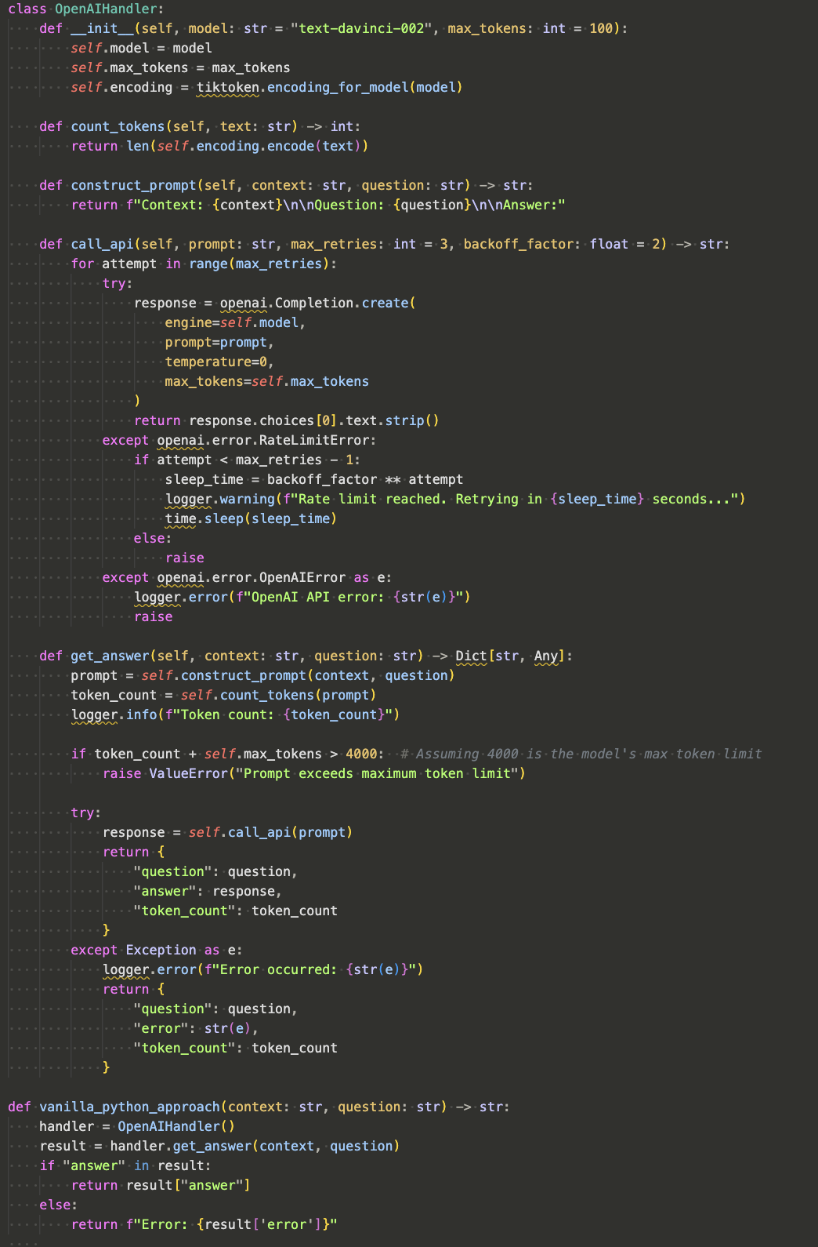
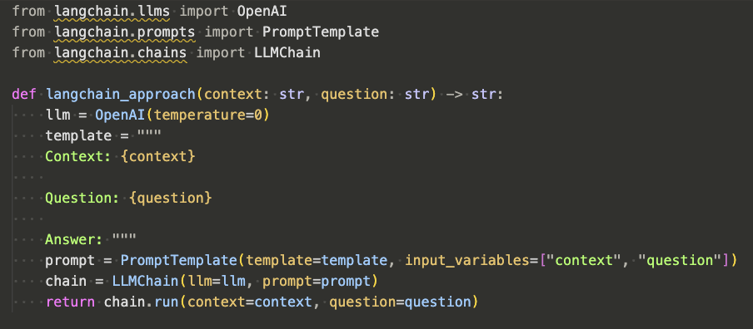
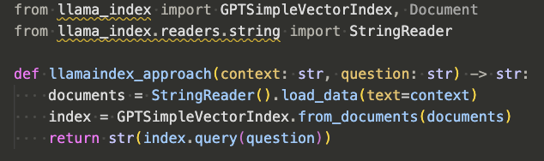
Pure Python vs. Custom Libraries
Development of LLM applications is typically done using the Python language
Vanilla Python can be used, but many pieces need to be built each time
Libraries like LangChain and LlamaIndex have been used to quickly modularize and speed up development of LLM applications
RAG with LangChain
RAG with LlamaIndex
RAG with Vanilla Python

Slide 18
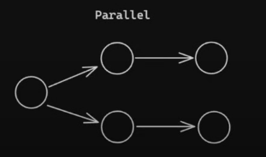
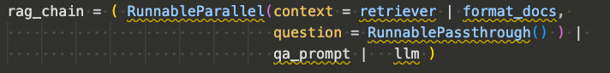
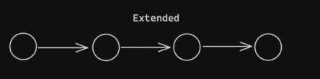
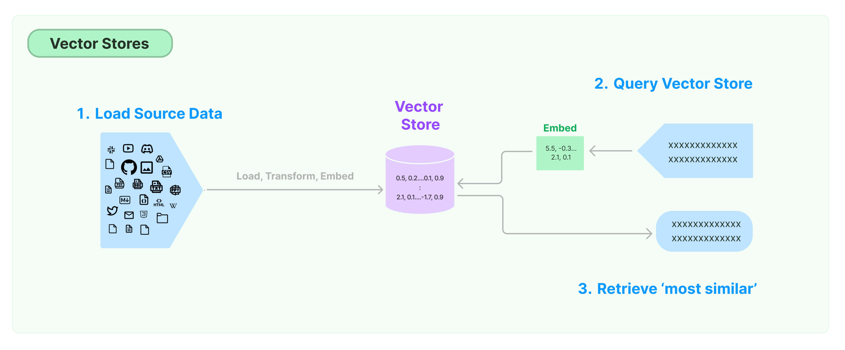
LangChain - Review
Previously we saw how LangChain provides a framework for working with LLM chains. We can leverage these chains to build complex LLM Compound Applications
LangChain offers the ability to use Serial and Parallel chaining structures
Provides out of the box solutions to parse unstructured data with various text splitting options:
“[The] text splitter is the recommended one for generic text. It is parameterized by a list of characters. It tries to split on them in order until the chunks are small enough. The default list is ["\n\n", "\n", " ", ""]. This has the effect of trying to keep all paragraphs (and then sentences, and then words) together as long as possible, as those would generically seem to be the strongest semantically related pieces of text.” – LangChain Docs
Interfaces seamlessly with many vector database providers:
Notes:
https://python.langchain.com/v0.1/docs/modules/data_connection/document_transformers/recursive_text_splitter/
https://medium.com/@shravankoninti/different-chain-types-using-langchain-89cacae6ad1f
https://python.langchain.com/v0.1/docs/modules/data_connection/vectorstores/

Slide 19

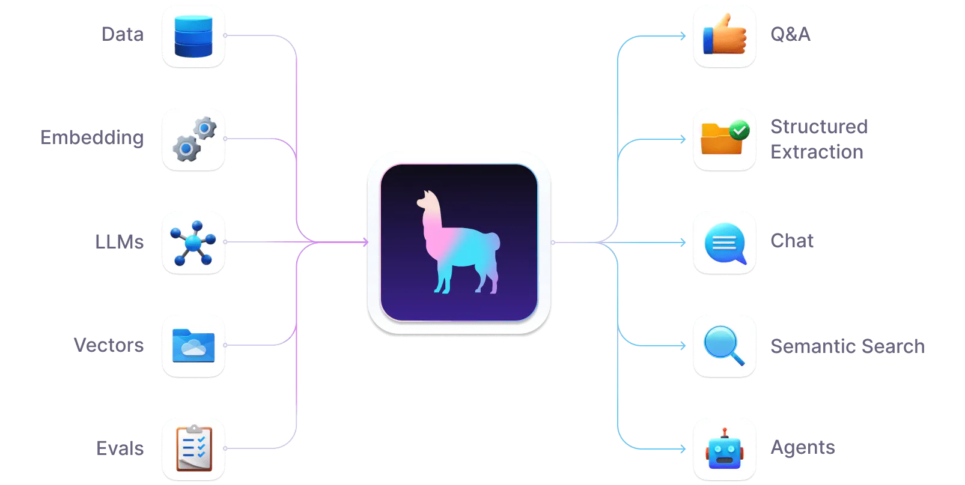
LlamaIndex – Managing Data for RAG
LlamaIndex vs. LangChain
Whereas LangChain’s focus is on LLM components, LlamaIndex focuses more specifically on RAG and data parsing.
LlamaIndex includes hundreds of data loaders to connect custom data sources to LLMs, including integrations with Airtable, Jira, Salesforce, and others, allowing seamless data loading from files, JSON, CSV, and unstructured data.
LlamaIndex offers various indexing models tailored for optimizing data exploration and categorization, enabling significant performance gains when using LLMs by choosing the appropriate index type for your application.
Notes:
https://docs.llamaindex.ai/en/stable/

Slide 20



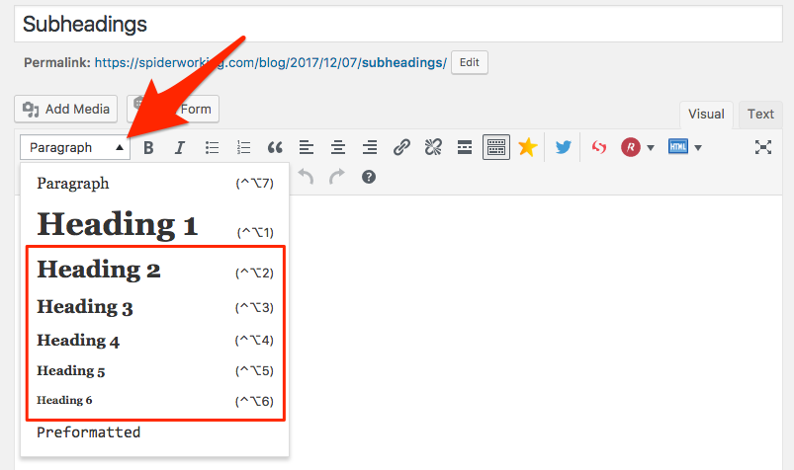
Data Formats and LLM Performance
There is no single best way to parse an arbitrary document:
Document types
PDFs
MS Word
Raw text
HTML/XML pages
JSON
MS PowerPoint
Markdown
Understanding how to parse even just these requires a strong understanding of their encodings and formats, many of which are proprietary
Formatting Differences
Even within a single document type, the sematic meaning of the document can be affected by how it is chunked:
Newlines
Headings/Subheadings
Page borders
Notes:
https://commons.wikimedia.org/wiki/File:Microsoft_PowerPoint_2013-2019_logo.svg
https://techterms.com/definition/pdf
https://www.macworld.com/article/812847/how-to-switch-to-single-page-view-in-microsoft-word-and-the-preview-app.html
https://spiderworking.com/blog/2017/12/07/how-to-write-subheadings/

Slide 21
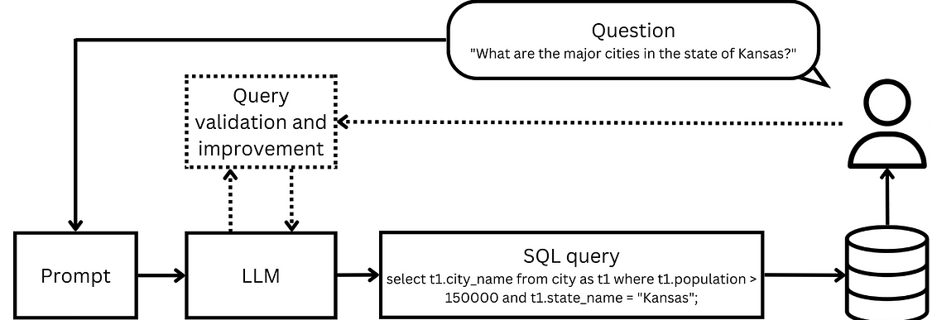
RAG with Structured Data: SQL RAG
Unstructured data, typically text, is common in RAG. But what if we need structured data?
Example: generate SQL queries
We can utilize an LLM to generate SQL queries from natural language to collect structured data as well.
These ‘Text2SQL’ models are becoming popular as developers want to include structured data with semantic data for RAG.
Notes:
https://towardsdatascience.com/enabling-the-data-driven-organisation-with-text2sql-f8e07089dd0c

Slide 22
Compound systems as programs: DSPy
A new look at LLM systems

Slide 23
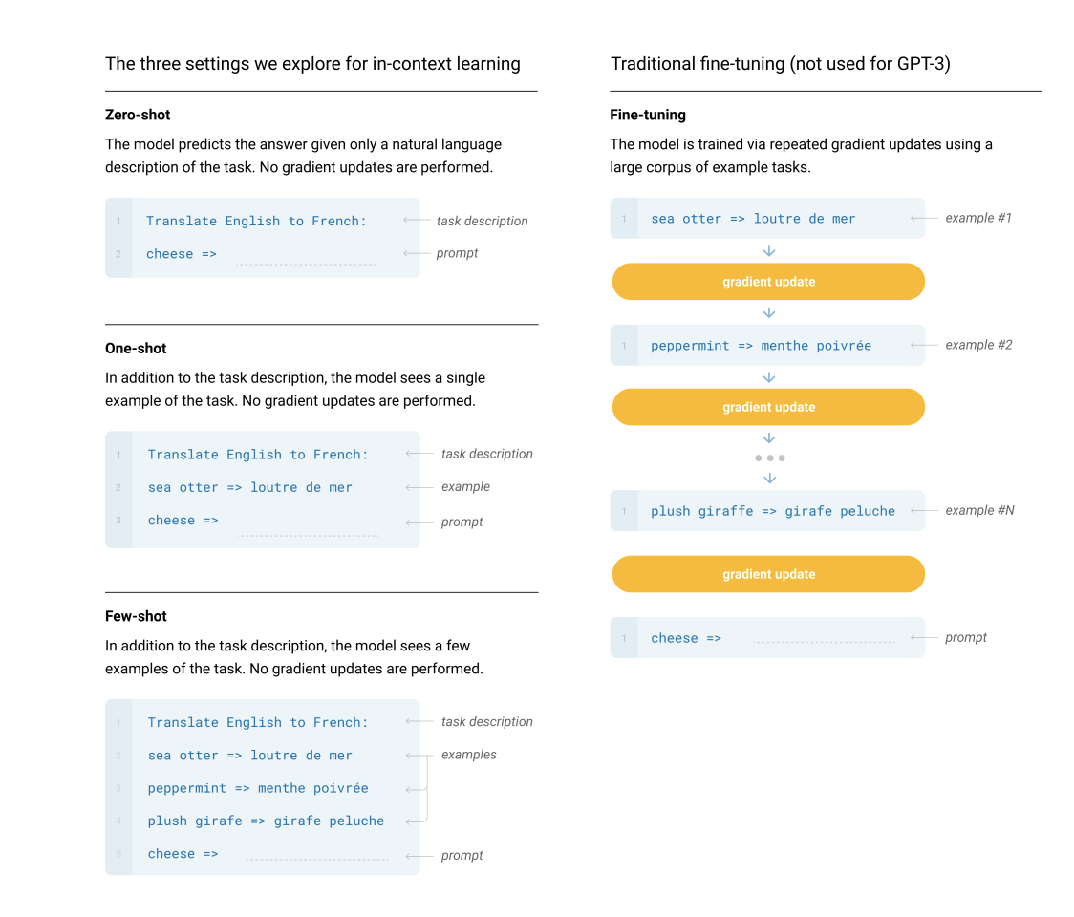
Prompt Engineering, Fine-Tuning, … or Programming?
LLM Compound Systems benefit from the best alignment of the models being used
If we don’t have enough data, we’re stuck at few-shot learning
If we have lots of good data, we can fine-tune the LLM for better alignment
What if there is another way? Can we make use of the full Compound System and the data available to tune our system?
(Ans: Yes! With DSPy)
Notes:
https://arxiv.org/pdf/2005.14165

Slide 24
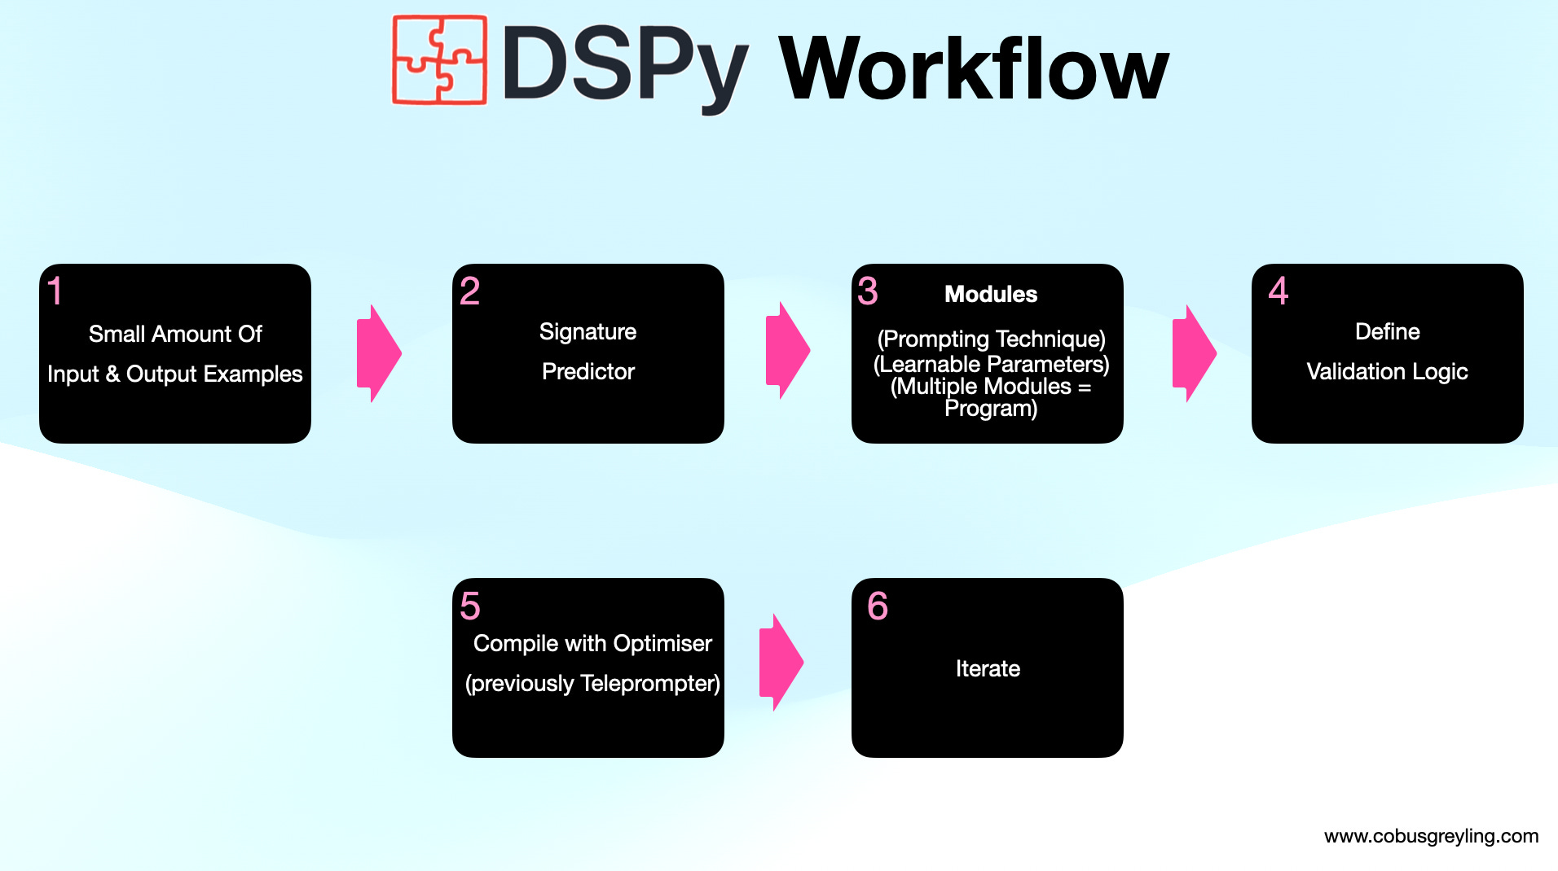
Declarative Self-improving Language Programs, pythonically: DSPy
DSPy is a framework for algorithmically optimizing LLM prompts and weights, especially when LLMs are used one or more times within a pipeline. To use LLMs to build a complex system without DSPy, you generally have to:
Break the problem down into steps,
Prompt your LLM well until each step works well in isolation,
Tweak the steps to work well together,
Generate synthetic examples to tune each step, and
Use these examples to finetune smaller LLMs to cut costs.
Currently, this is hard and messy: every time you change your pipeline, your LLM, or your data, all prompts (or finetuning steps) may need to change.
DSPy separates the flow of the program (modules) from the parameters (LLM prompts and weights) of each step.
Notes:
https://cobusgreyling.substack.com/p/an-introduction-to-dspy

Slide 25
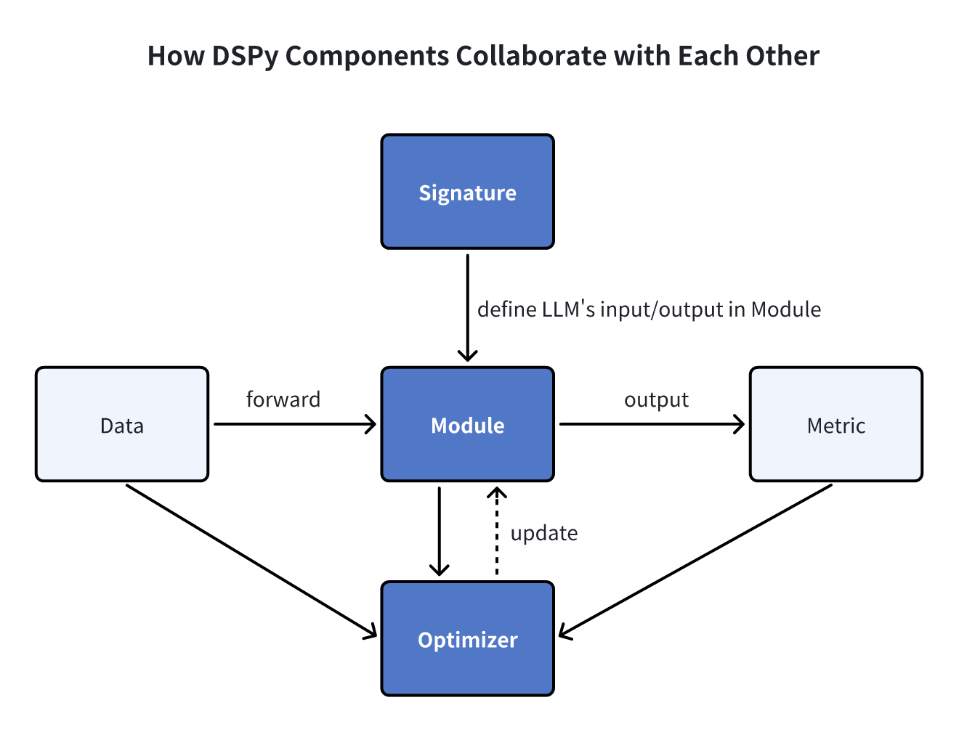
DSPy Components
Modules
A DSPy module is a building block for programs that use LMs. Each built-in module abstracts a prompting technique (like chain of thought or ReAct). Crucially, they are generalized to handle any DSPy Signature.
Signatures
A signature is a declarative specification of input/output behavior of a DSPy module. Signatures allow you to tell the LM what it needs to do, rather than specify how we should ask the LM to do it.
LMs
A DSPy LM are the LLMs that we are familiar with already
Optimizers
A DSPy optimizer is an algorithm that can tune the parameters of a DSPy program (i.e., the prompts and/or the LM weights) to maximize the metrics you specify, like accuracy.
Notes:
https://zilliz.com/blog/exploring-dspy-and-its-integration-with-milvus-vector-database-for-RAG

Slide 26
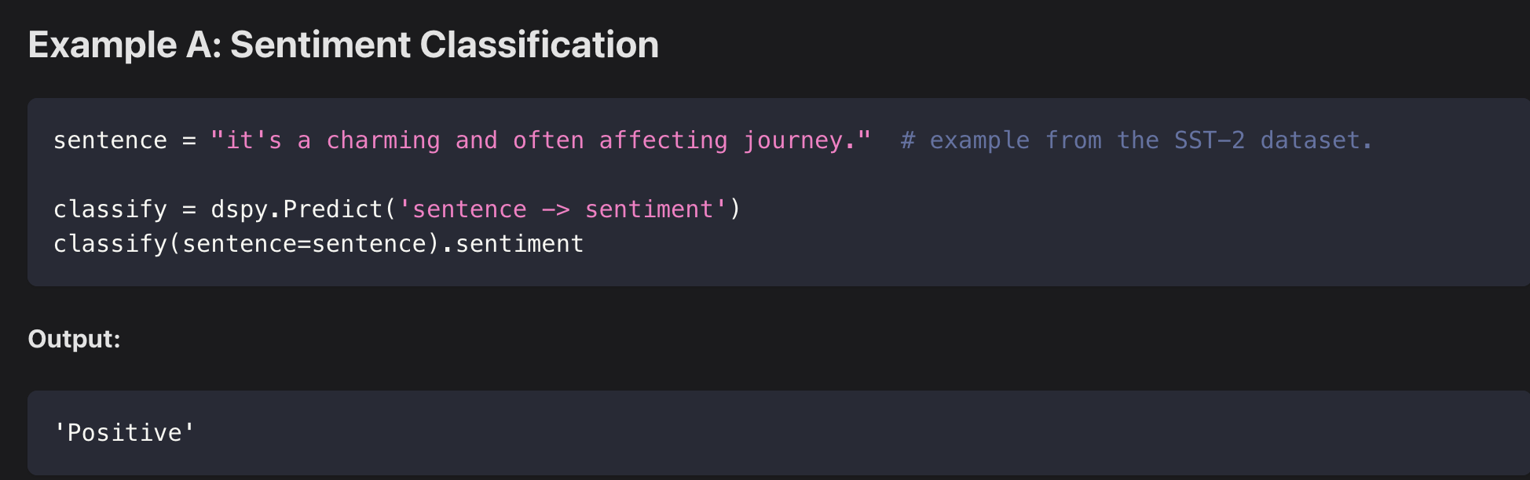
DSPy LMs and Signatures
Signatures can be defined as a short string, with argument names that define semantic roles for inputs/outputs.
Question Answering: "question -> answer"
Sentiment Classification: "sentence -> sentiment"
Summarization: "document -> summary"
Your signatures can also have multiple input/output fields.
Retrieval-Augmented Question Answering: "context, question -> answer"
Multiple-Choice Question Answering with Reasoning: "question, choices -> reasoning, selection"
Notes:
https://dspy-docs.vercel.app/docs/building-blocks/language_models
https://dspy-docs.vercel.app/docs/building-blocks/signatures

Slide 27
DSPy Modules
A DSPy module is a building block for programs that use LMs.
Each built-in module abstracts a prompting technique (like chain of thought or ReAct). Crucially, they are generalized to handle any DSPy Signature.
A DSPy module has learnable parameters (i.e., the little pieces comprising the prompt and the LM weights) and can be invoked (called) to process inputs and return outputs.
Multiple modules can be composed into bigger modules (programs). DSPy modules are inspired directly by NN modules in PyTorch, but applied to LM programs.
dspy.Predict: Basic predictor. Does not modify the signature. Handles the key forms of learning (i.e., storing the instructions and demonstrations and updates to the LM).
dspy.ChainOfThought: Teaches the LM to think step-by-step before committing to the signature's response.
dspy.ProgramOfThought: Teaches the LM to output code, whose execution results will dictate the response.
dspy.ReAct: An agent that can use tools to implement the given signature.
Notes:
https://dspy-docs.vercel.app/docs/building-blocks/modules

Slide 28
DSPy Optimizers
A DSPy optimizer is an algorithm that can tune the parameters of a DSPy program (i.e., the prompts and/or the LM weights) to maximize the metrics you specify, like accuracy.
There are many built-in optimizers in DSPy, which apply vastly different strategies. A typical DSPy optimizer takes three things:
Your DSPy program. This may be a single module (e.g., dspy.Predict) or a complex multi-module program.
Your metric. This is a function that evaluates the output of your program, and assigns it a score (higher is better).
A few training inputs. This may be very small (i.e., only 5 or 10 examples) and incomplete (only inputs to your program, without any labels).
If you happen to have a lot of data, DSPy can leverage that. But you can start small and get strong results.
Notes:
https://dspy-docs.vercel.app/docs/building-blocks/optimizers

Slide 29


DSPy vs. LlamaIndex vs. LangChain
LangChain and LlamaIndex target high-level application development; they offer batteries-included, pre-built application modules that plug in with your data or configuration.
If you'd be happy to use a generic, off-the-shelf prompt for question answering over PDFs or standard text-to-SQL, you will find a rich ecosystem in these libraries.
DSPy doesn't internally contain hand-crafted prompts that target specific applications.
Instead, DSPy introduces a small set of much more powerful and general-purpose modules that can learn to prompt (or finetune) your LM within your pipeline on your data. when you change your data, make tweaks to your program's control flow, or change your target LM, the DSPy compiler can map your program into a new set of prompts (or finetunes) that are optimized specifically for this pipeline
Notes:
https://dspy-docs.vercel.app/docs/faqs

Slide 30
Evaluation of LLMs and Compound Systems
Checking our work

Slide 31

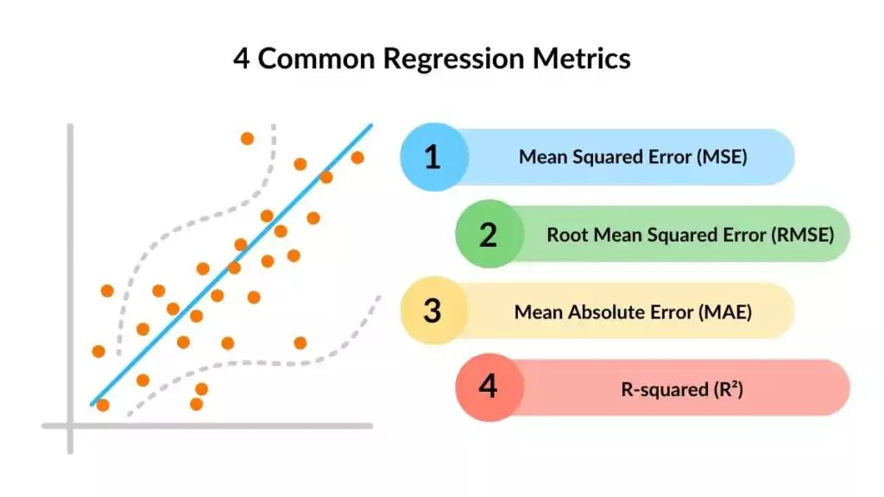
Evaluating Models: Supervised Learning
For traditional machine learning models, and for deep learning models, evaluation is straightforward as there is a specific set of inputs and outputs that the model uses to train on.
We can test how well the model performs by starting with known input and output pairs and seeing how well the model predicts the output from a given input.
Classification Models
Precision
Recall
ROC Curve
F1 score
Regression Models
Mean Squared Error
R-squared
What about LLMs?
Notes:
https://spotintelligence.com/2024/03/27/regression-metrics-for-machine-learning/
https://www.jeremyjordan.me/evaluating-a-machine-learning-model/

Slide 32
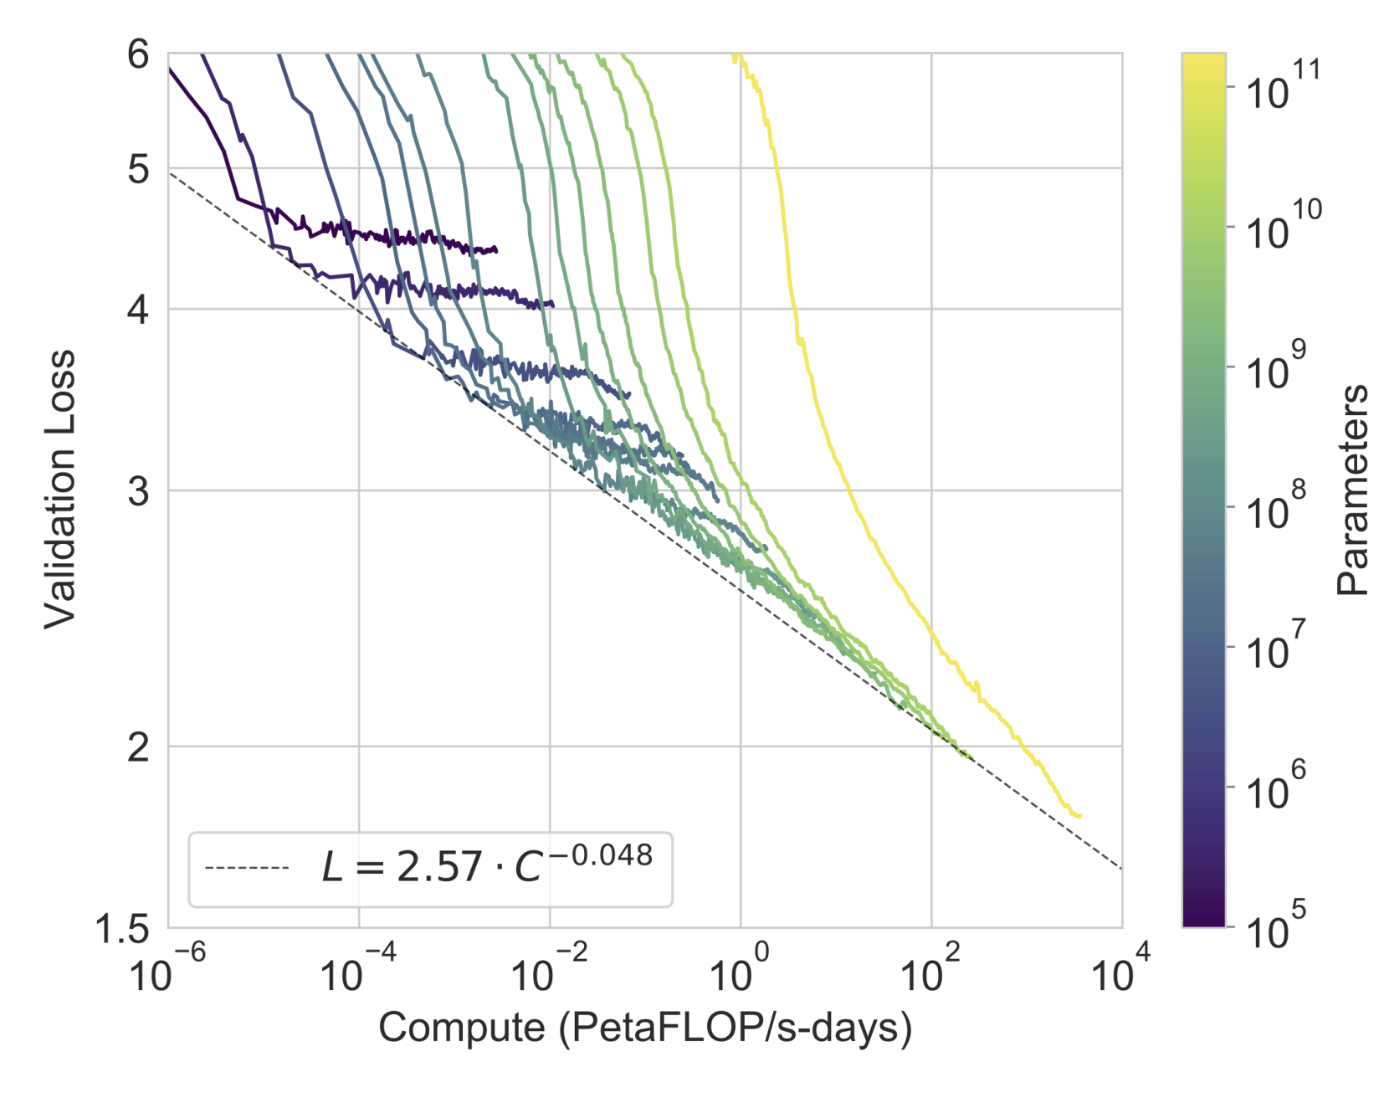
Why LLM systems are hard to evaluate
Consider how an LLM like GPT-3 is trained
LLM predicts the next token.
We know, in the training data, which is the “correct” token, this is how we calculate loss.
So evaluation should be simple, follow the loss?
Nope!
Recall that the real power of GPT-3 and the models that came after it relied on in-context learning and the power of few-shot learning.
The loss curves indicate that the model can understand language, but to evaluate something like a RAG system, this doesn’t give us any information at all…
Notes:
https://arxiv.org/abs/2005.14165v4

Slide 33
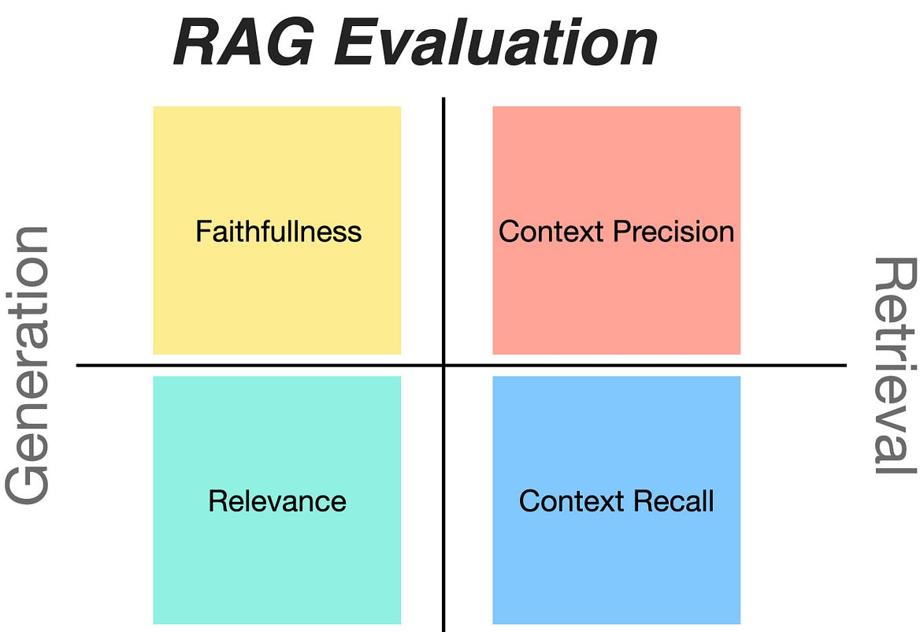
Evaluating a RAG System
Let’s consider what the task is for RAG and see where we can evaluate the performance.
RAG Pipeline:
1. Take user’s input and search for similar content
2. Retrieve similar content from Vector Database
3. Combine user input and context into a single prompt
4. Generate the answer to the user’s query
We can look at each of these stages and consider how we might evaluate it.
Retriever Evaluation
How well does the retriever find the right content?
If multiple records are returned, is the best one at the top?
Generation Evaluation
How well does the model use the content to answer the user’s query?
How much of the content retrieved is used in answering the user’s query?
Note that we are using very subjective terminology. “How well” something is done can be very hard to measure in natural language.
Notes:
https://cobusgreyling.medium.com/combining-ragas-rag-assessment-tool-with-langsmith-e46078001f95

Slide 34

Using an LLM to judge another LLM?
LLMs excel at interpreting their context window. More so than generate new text. This means that we can use an LLM to effectively judge the performance of an LLMs generated answer.
We can look at 3 LLM-as-a-judge variations. They can be implemented independently or in combination:
Pairwise comparison. An LLM judge is presented with a question and two answers, and tasked to determine which one is better or declare a tie.
Single answer grading. Alternatively, an LLM judge is asked to directly assign a score to a single answer.
Reference-guided grading. In certain cases, it may be beneficial to provide a reference solution if applicable with a grading scale.
Each of these methods require different amounts of data but offer more structured approaches to evaluating the performance of an LLM system.
Notes:
https://arxiv.org/pdf/2306.05685

Slide 35
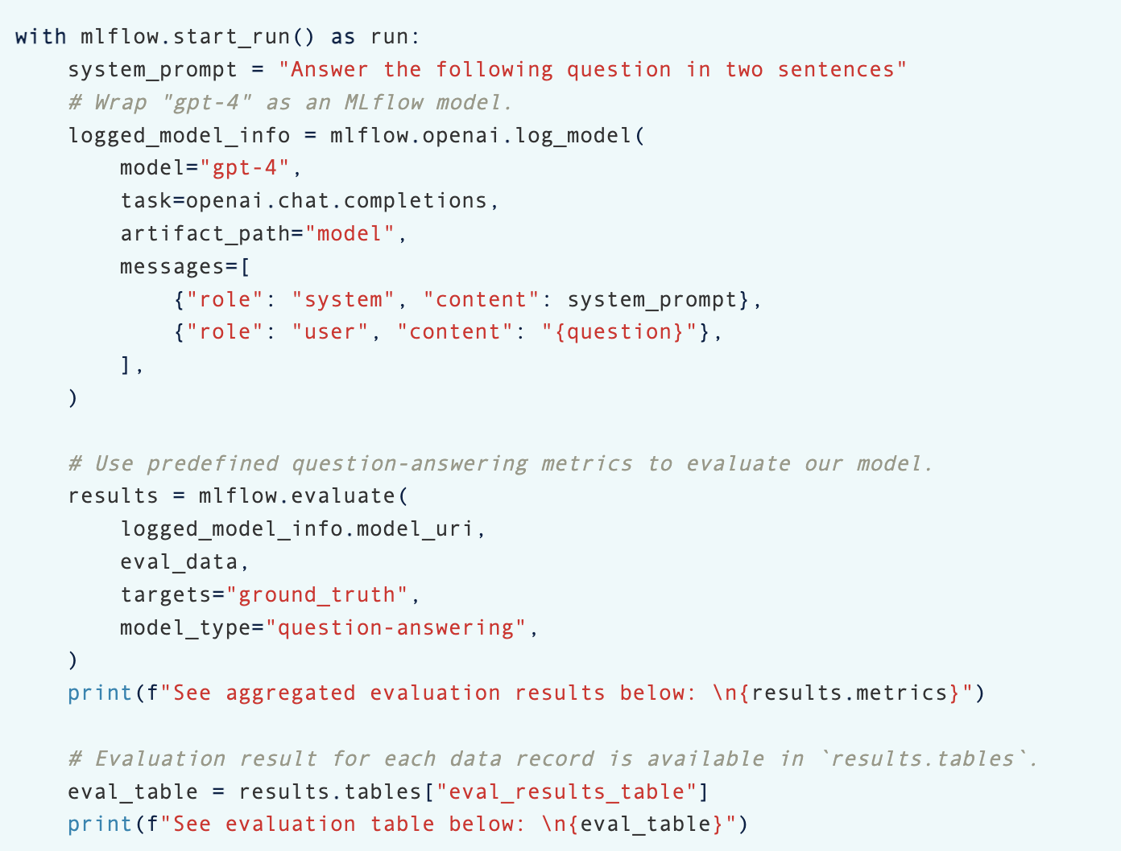
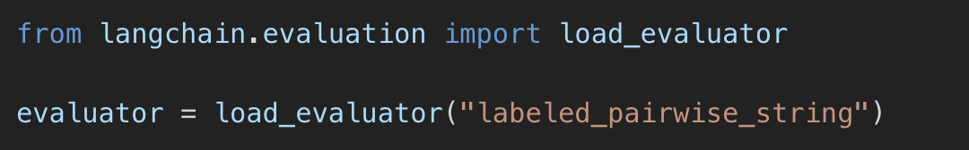

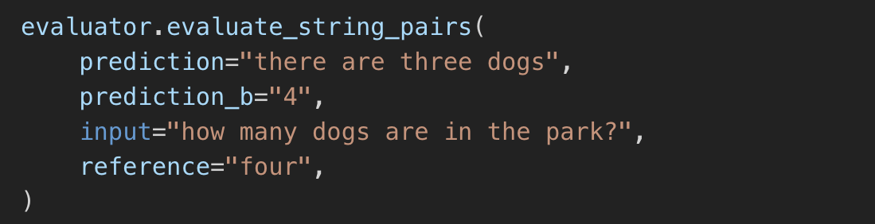

Evaluation Frameworks
Frameworks like LangChain and MLflow offer support to implement evaluation of LLMs
Notes:
https://python.langchain.com/v0.1/docs/guides/productionization/evaluation/comparison/pairwise_string/
https://mlflow.org/docs/latest/llms/llm-evaluate/index.html

Slide 36
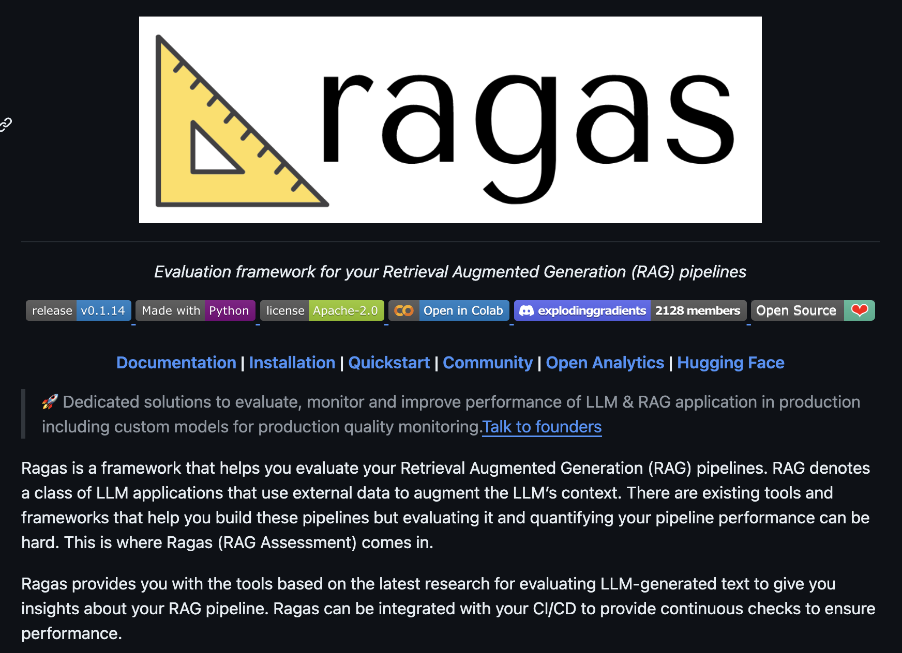
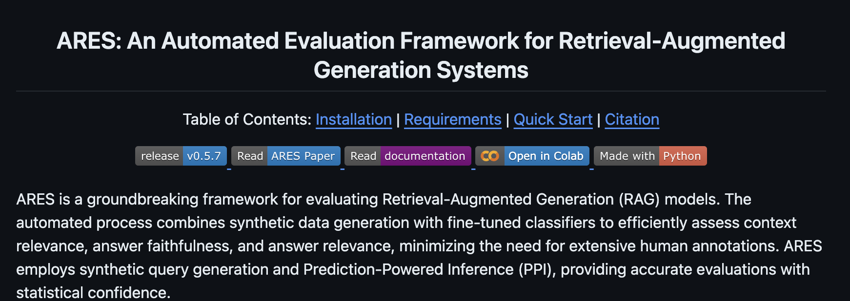
Evaluation Frameworks: RAGAS and ARES
We are also seeing the development of new evaluation-focused frameworks such as RAGAS and ARES
Notes:
https://github.com/explodinggradients/ragas
https://github.com/stanford-futuredata/ARES

Slide 37
Wrap Up
LLM Compound Systems
Today we reviewed more concepts of LLM Chains in LangChain
Introduced the Retrieval Augmented Generation LLM System
Explored the libraries that have been developed to build LLM Compound Systems like LlamaIndex and DSPy
Discussed the issues with evaluating LLMs and Compound systems
-----------------------------------------------------------------------------
In the next lesson we will introduce the concept of LLM agents and explore how LLMs can be used as reasoning engines inside more complex applications

Slide 38
Thank you!

